Slide 1

RESHAPING YOUR PERSONAL EXPENSE TRACKING WITH
MULYA

Slide 2
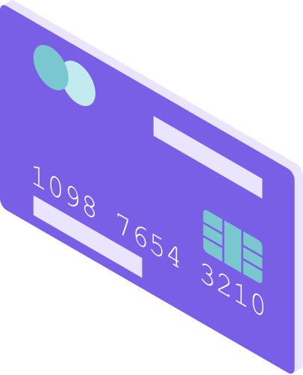


What is it?

Slide 3
It’s a PET (Personal Expense Tracker)
01 | Effortlessly monitor your spending
02 | Identify areas for saving
03 | Achieve your financial goals with ease
04 | Goodbye to the chaos of paper receipts and spreadsheets
05 | Insights into your financial habits
06 | Informed decision making regarding your finances
A tool that is designed to empower you to take control of your finances like never before.

Slide 4









Slide 5
MULYA
1. | Helps you to register your Expense time to time
2. | Categorize your Expenses to set limit for each category
3. | Savings can be increased
4. | Helps in avoiding over spending.

Slide 6

What’s Next ?
Future plans regarding the *MULYA*
01 | Budget adding and Notifications on spending
02 | Category wise limits on spending
03 | Continuous investment in cybersecurity and security technology.
04 | A better conscious focus on mental health.
05 | Greater geographic distribution and representation of the workforce.

Slide 7
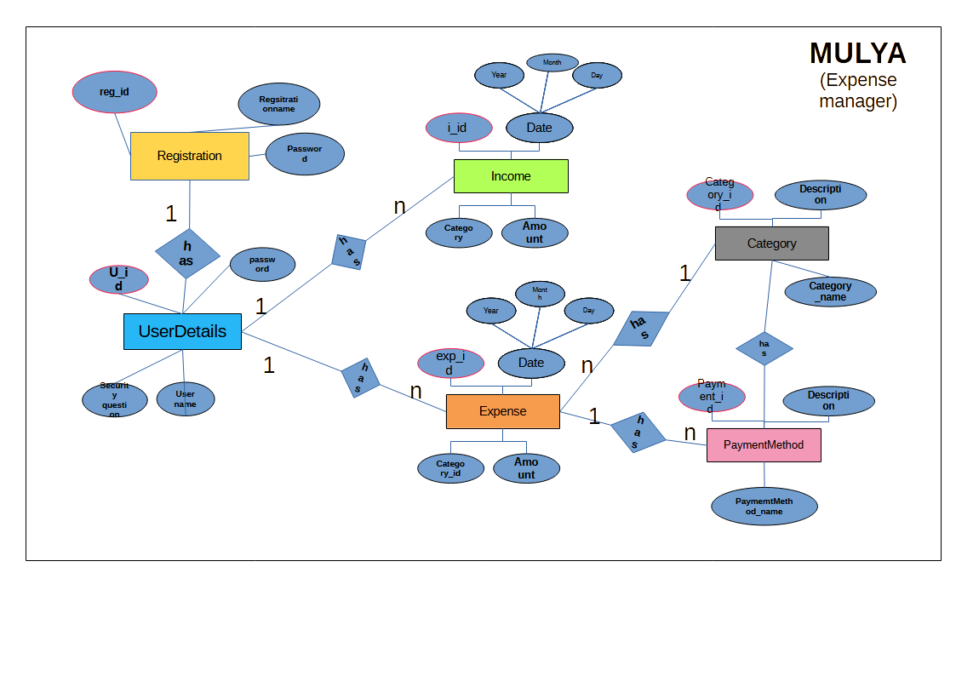
Technical Specifications :

Slide 8
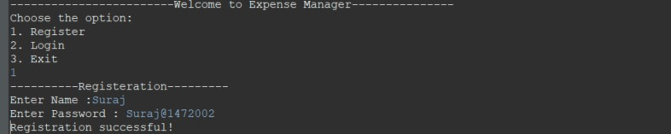
SCREENSHOTS:
OPTIONS (what customers loves) 1st prompt
2nd Prompt (User Registration)

Slide 9
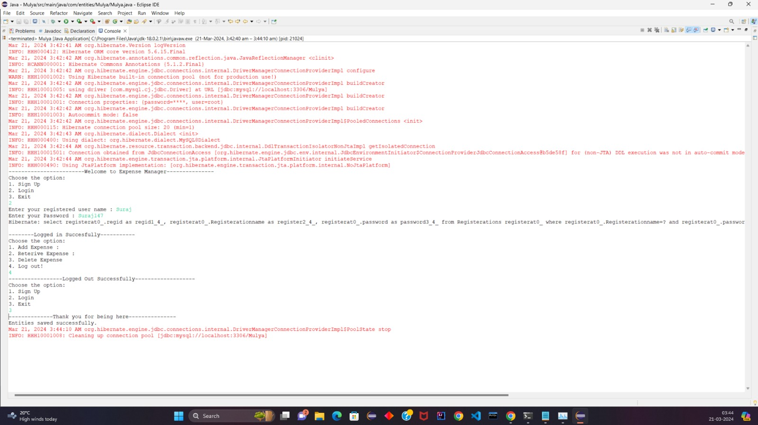
Login after Registration
Menu after LOGIN

Slide 10
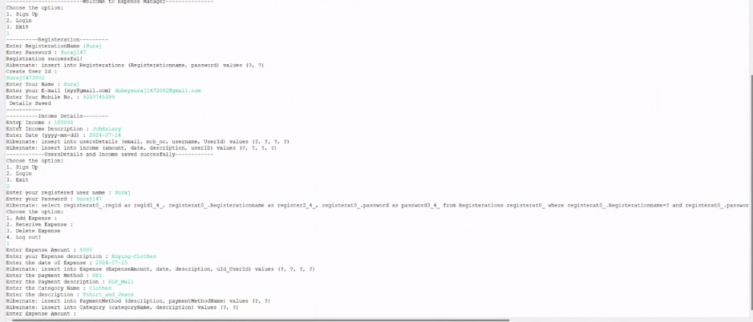
Adding income in Registration
Menu after LOGIN

Slide 11
If User choose to “Add Expense”

Slide 12
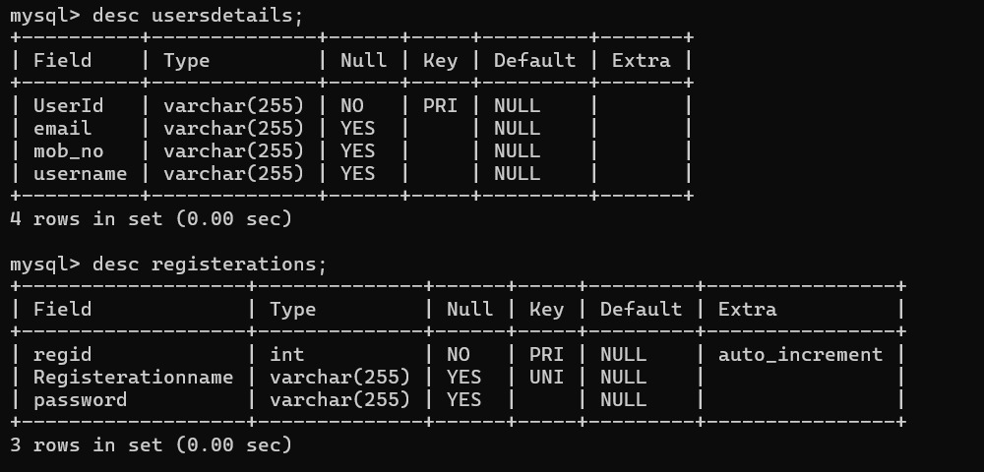
Description of Database:

Slide 13
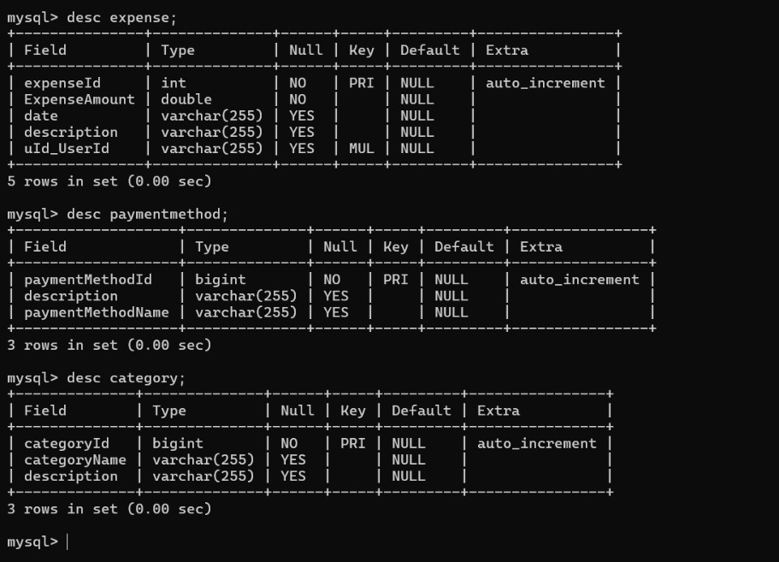

Slide 14
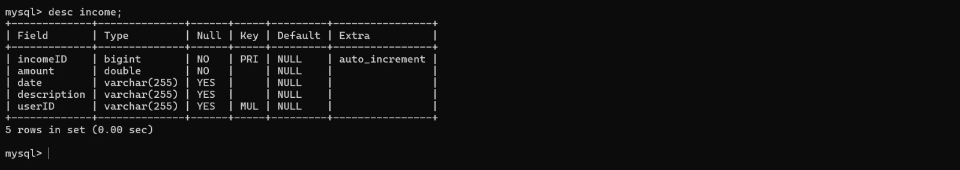

Slide 15
ThankYou
RUZUL SHARMA & SURAJ DUBEY

